Slide 1
2018 Us Live birth Correlations
Group Members:
Felix, Sneha, Chandler, Erika,
With Special Appearances by:
Amanda and Doc. A
Karl

Slide 2




Interesting Questions to Answer
Are Birth rates correlated to a Holiday?
What month has the highest/lowest number of live births?
What state has the highest/lowest birth rate?
Do Major Events impact Number of Live Births ?

Slide 3


Data Resources
Census data to show the population of each state: 2019 National and State Population Estimates
CDC Data to show number of live births: State and National Provisional Counts
Data Limitations to Consider:
Stillborn births
Preemie births - all live births treated as full term
MTB moving from one state to another within their pregnancy
Only had one year’s data available of usable data to evaluate
more accurate trends

Slide 4




Thought Process…
Find total of live birth count in each state
Using the data obtained from the CDC website, we were able to clean it and only remain with number of live births for the purpose of our project.
Calculating the birth rate per state
This was done so as to not skew the data, It can be done by dividing the number of live births by the total population then multiply by 1000.
Using code on the grouped data to transform the numbers into charts. To easier see movement and trends.
Analyzing the data.
Grouping the data
After calculating the birth rate per state , we were able to find the state with the highest and lowest birth rate and average birth rate per state.
We grouped the data by month to determine the number of live births by month for each state. As a result we which month has the highest and which month has the lowest found.
Visualizing the Data

Slide 5
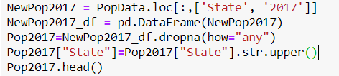
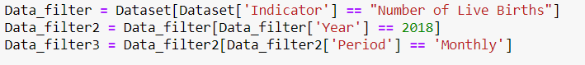
Cleaning the Data
Imported both csv files downloaded from the aforementioned websites.
Dropped unwanted rows in the csv files and filtered the data by
number of live births
the year 2018
period is by month
Switched the case on the state column to .upper() to enable merging the two CSVs; census and number of live births.

Slide 6
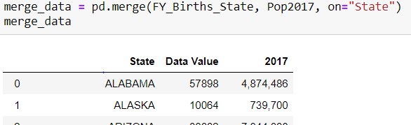

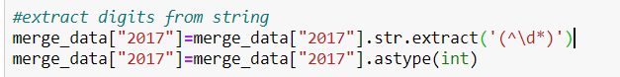
Cleaning the Data
Merged the census data and birth data on the state column.
Removed commas from 2017 column in the merged data then changed the type from string to integer.

Slide 7
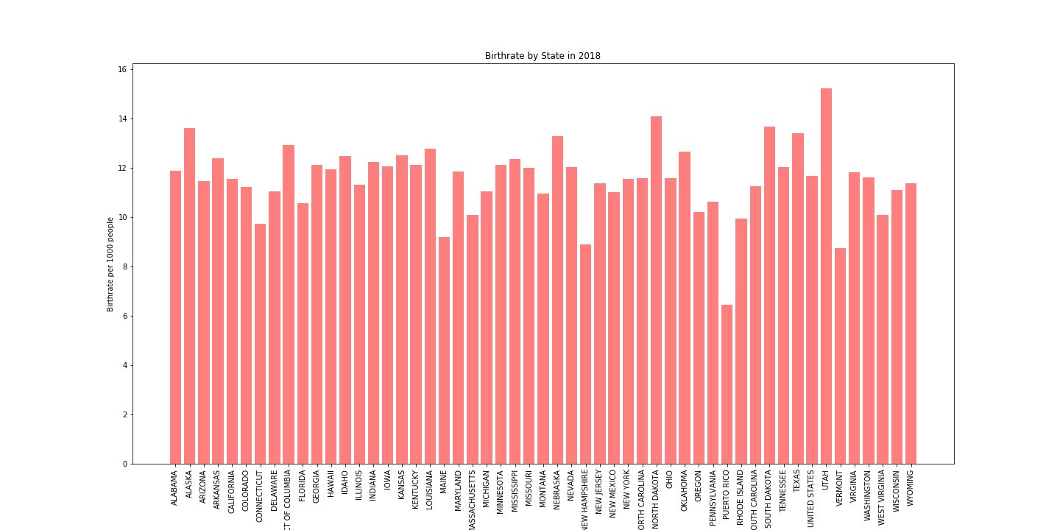
Visualizing the Birth Rate Comparison by State
US Birthrate is at 11.6
xx

Slide 8
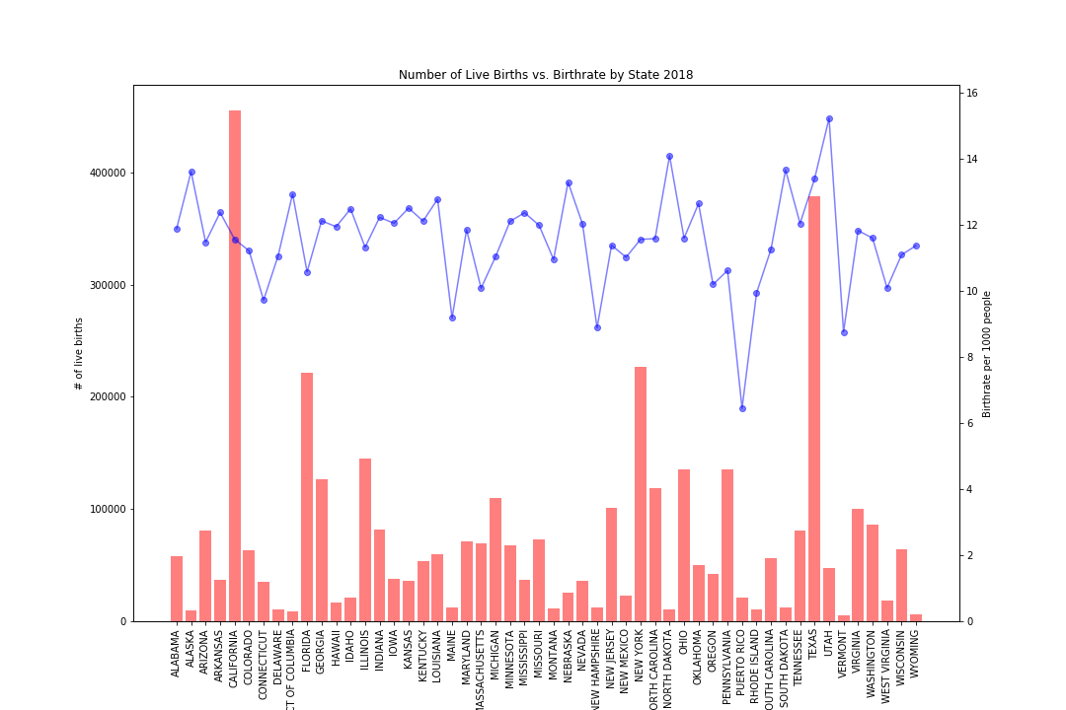

Birth Rate vs Birth Values
Comparing Number of Live Births per State to the Birth rate reveals which states are contributing more than fair share to the population → Such as Alaska, Nebraska, North & South Dakota , and Utah
Maine, New Hampshire, Puerto Rico and Vermont are below the average
California, for example, has the highest number of live births but its birth rate is in line with the average.

Slide 9
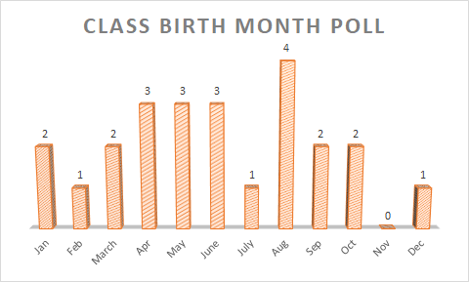
CLASS POLL: WHAT IS YOUR BIRTH MONTH?
How does the class results compare to the US Trends of 2018?

Slide 10
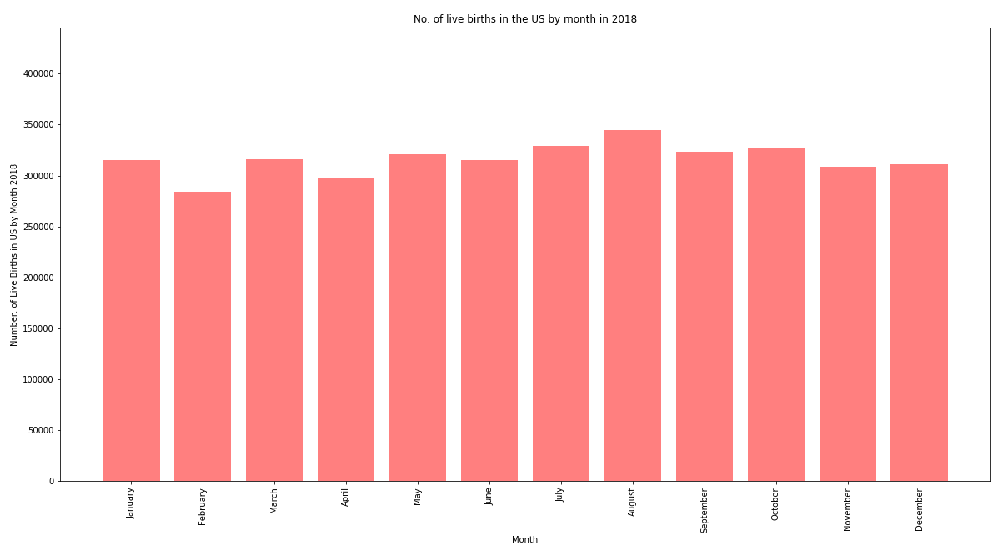
Number of Live Births by Month in US for 2018
284,000
315,000
329,000
327,000
315,000
316,000
298,000
321,000
345,000
309,000
311,000
323,000

Slide 11
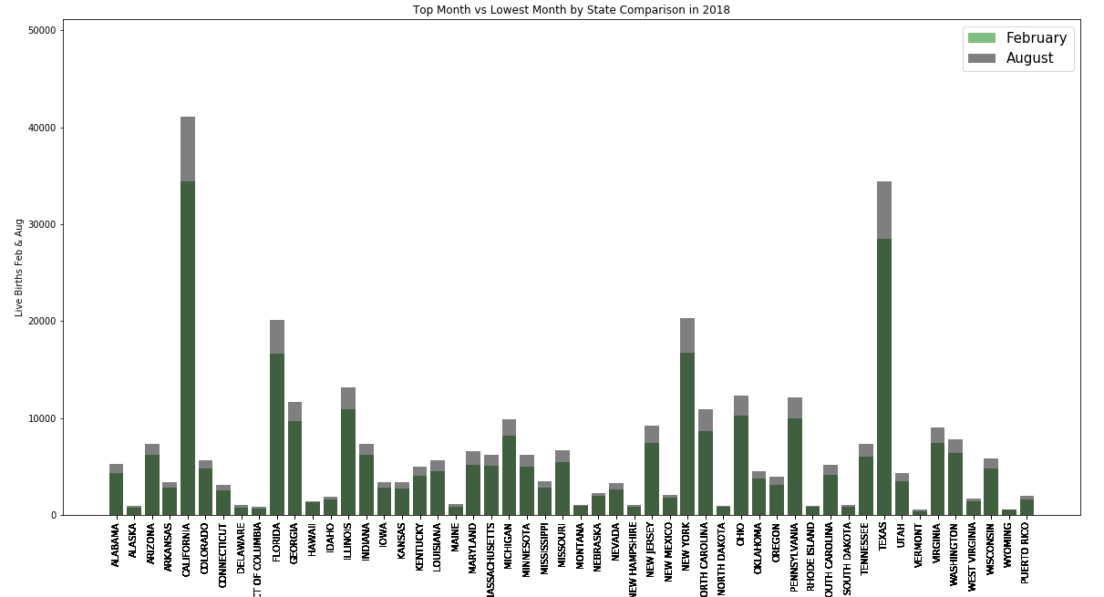
February vs August Live Births Comparison

Slide 12
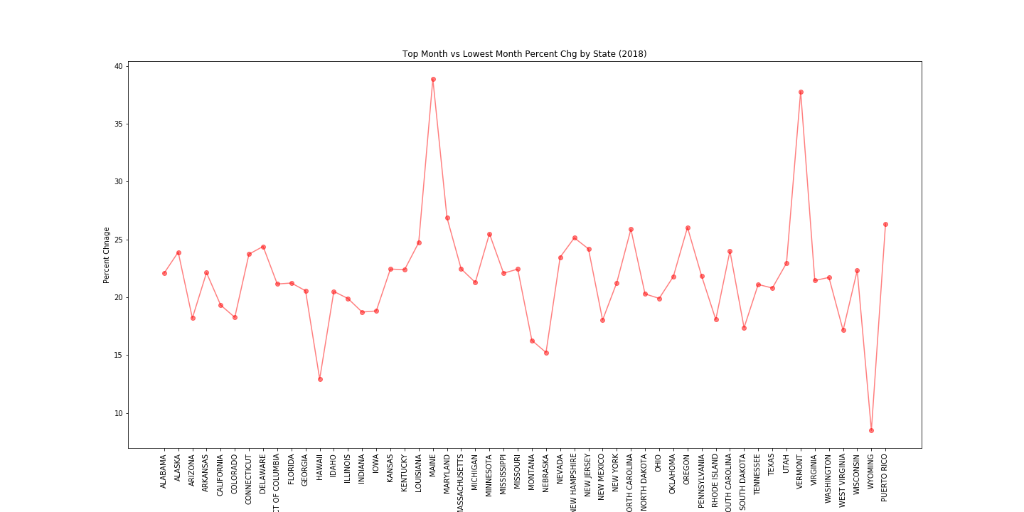
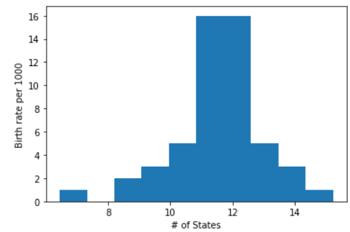
Birth Rate Difference Between Lowest & Highest Birth Month by State
+38.8%
+22.9%
+12.9%
+8.4%
Maine & Vermont have the highest disparity in births between feb and aug
Hawaii and Wyoming have the lowest disparity implicating consistent births given Feb/Aug are the highest/lowest months.

Slide 13
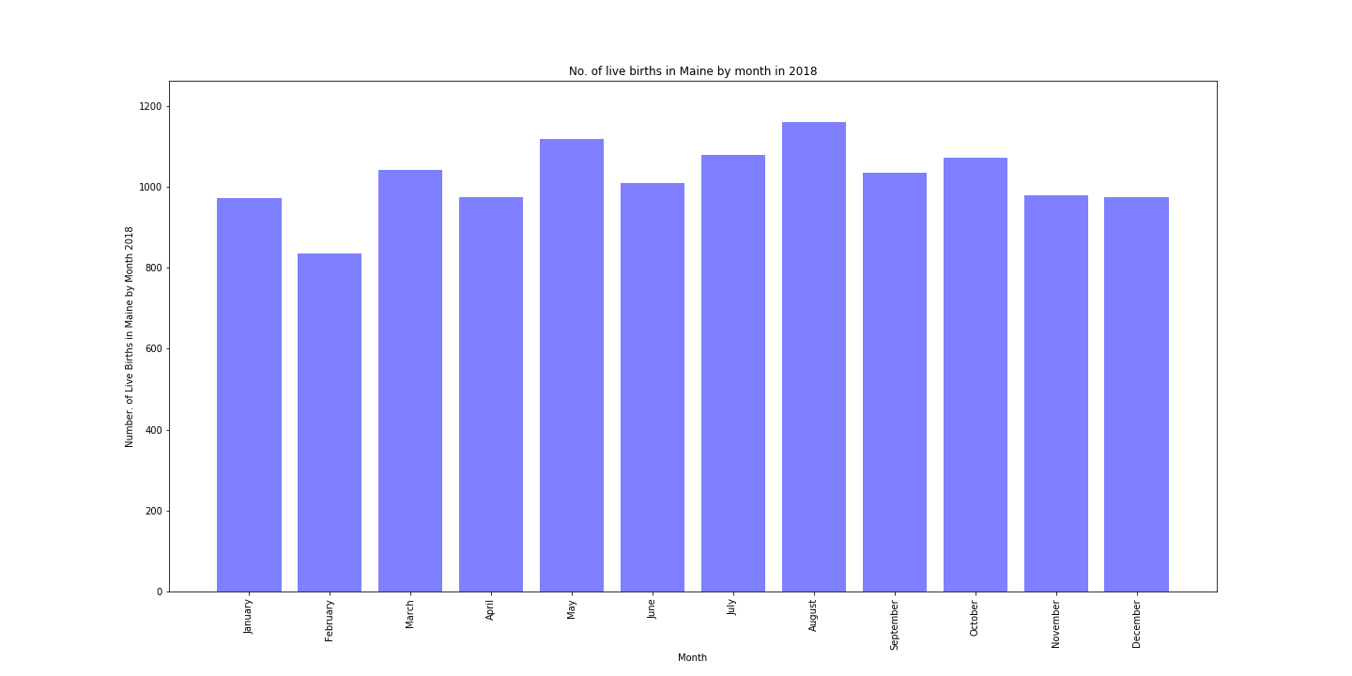
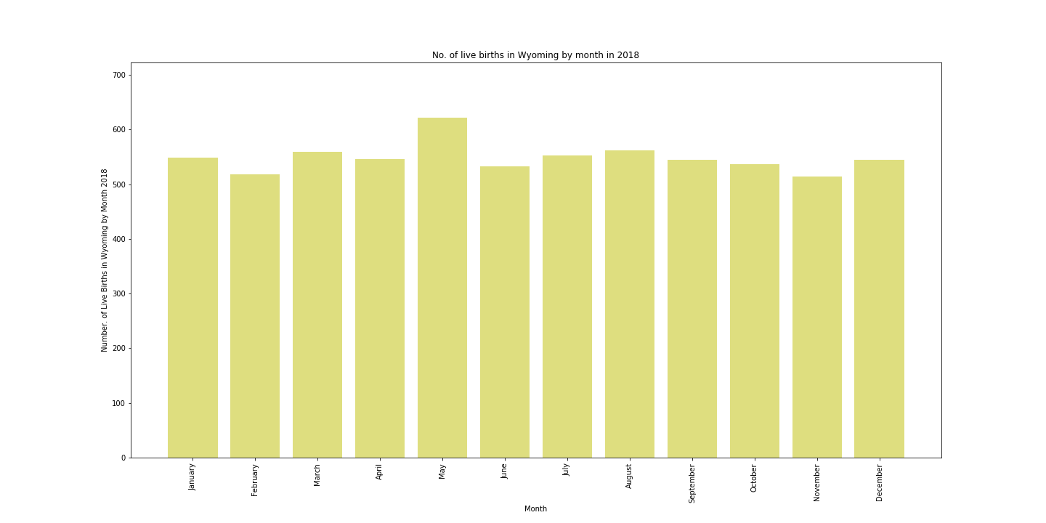
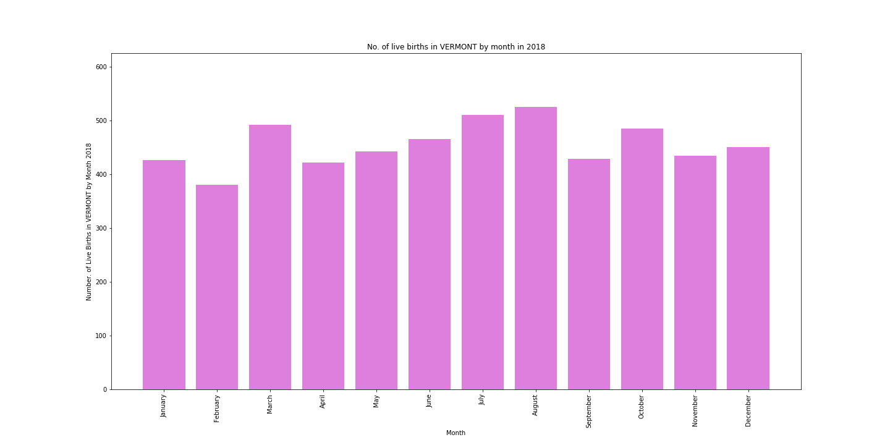
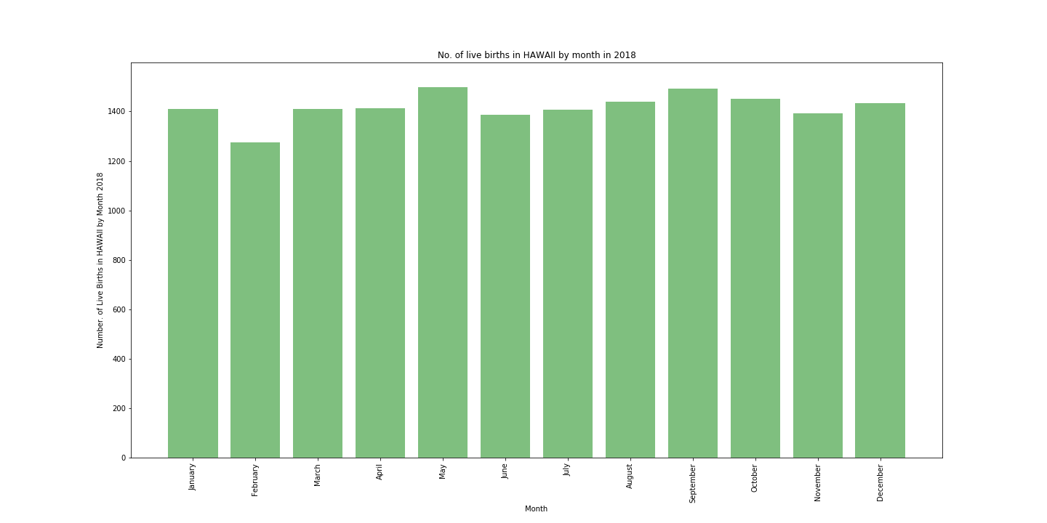
Digging Deeper Into the Outliers Reveals Different Conclusions on Peak Months
Maine
33%
Wyoming
17%
Vermont
Hawaii

Slide 14








Is Number of Live Births in the United States for 2018 Seasonal?
*Holiday Icon corresponds to the holiday of 8-9mos. prior

Slide 15




Findings Implications
Big events such as the Superbowl, major hurricanes, the solar eclipse, etc. don’t seem to have much of an effect on birthrates
With August having the most live births across the US, and February having the least, we can determine that people are generally “busier” during the colder months of the year and that December is the “busiest” month for many people

